Slide 1
Assessing the Trialogue options for the EU ETS reform
This document provides summary material and charts examining position adopted by the ENV Council and European Parliament on the reform of the EU ETS in the period 2021-2030.
Contact suzana@sandbag.org.uk to discuss European Parliament position and ola@sandbag.org.uk with any questions regarding the ENV Council’s proposals.

Slide 2
Emissions projections vs cap – likely to remain below cap for most of 2020s
In 2015 ETS, 42% of EU ETS emissions from coal generation.
Sandbag’s base case emissions: Replacing all the coal capacity with gas, but replacing it with renewables delivers Sandbag’s low case emissions.
Welcome progress on emissions reductions; but the ETS needs to play a role.
2013-2016 =-2.8% per year
Sandbag Base = 1.2% per year
Sandbag Low = 2.8% per year
Notes:
2015 1800, 42%=756. so in 2030 if 0% coal, base emissions more or less at base case if gas replaces it, low emissions if RES

Slide 3
Base emissions, 2x MSR rate, General Approach cancellation: 2030 surplus on the market 0.5Bt, and 637Mt in the MSR

Slide 4
Low emissions, 2x MSR rate, General Approach cancellation: 2030 surplus on the market 2.1Bt and 428Mt in the MSR

Slide 5
EP proposal; Base emissions; 2x MSR rate; 800Mt cancelled: 2030 market surplus 448Mt, 2.8Bt in the MSR

Slide 6
EP proposal; Low emissions; 2x MSR rate; 800Mt cancelled: 2030 market surplus 2Bt, 4.5Bt in the MSR

Slide 7
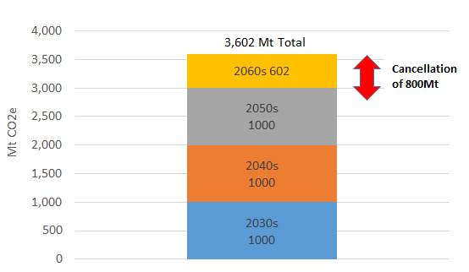
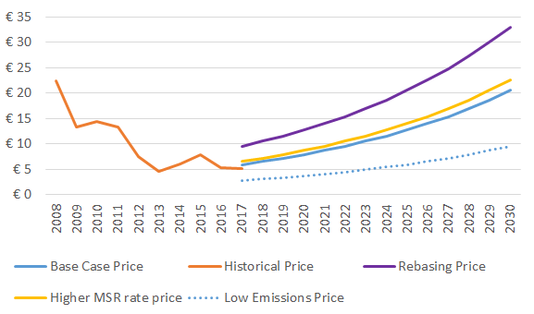
The relative difference of price effects of the different options that affect the surplus on the market
Doubling the MSR withdrawal rate initially reduces the surplus more quickly, but only 42 M tonnes difference in 2030.
Cancellations from the MSR will only affect prices in the 2060s (EP) or 2030s at the earliest (Council) - the volumes returned are limited.
Price trajectories: This is not a forecast. The numbers reflect the expectation that a market clearing price of €30 would be the cost-effective price for abatement in the ETS.

Slide 8
How to ensure the impact of the reform is robust for effects of overlapping policies on real emissions?
Other options – can they improve the proposal?
Member States annual cancellation - impossible to foresee impact, likely insignificant unless Member States pledge to cancel their allowances;
Potential LRF increase to 2.4% in 2024 as a part of post-Paris review, so overall a 2.3% LRF for the whole decade, an increase of a 0.1% - insignificant;
Carryover of significant volume of allowances from Phase 3 (up to 470Mt under the Council proposal) instead of placing them in the MSR – potentially significant and should be discouraged.
Increase further the MSR intake rate and apply it throughout the Phase;
Re-base the cap in line with real emissions at the end of Phase 3 and place the equivalent amount of allowances into the MSR.

